Slide 1
Excelerate Data Analysis Insights & Validation
Week: 3
Team: 12
Prepared by,
Mahir Faisal Chowdhury

Slide 2
Report structure
Introduction
Validation
Mission Statement - what are we trying to discover
Findings
Summary and & Key metrics
Further explanation & Charts
Trends
Comparative analysis
Recommendations

Slide 3
Introduction
The purpose of this presentation is to identity key trends in the outreach campaigns, and to identify ways of improving campaign success.
What makes a campaign successful? And how can we ensure that more of the applicants get responses to their inquiries?
This presentation also contains the validation of the dashboard. (maybe we should present this in a tabular or side-by-side format)

Slide 4

Data Validation
Data Consistency Check
Data types & formates
Correlation between key identifiers
Completeness Verification
Finding missing values
Duplicate Detection
Finding duplicate entries
Business Rule Validation
Connected & disconnected calls matchs total calls
Campaign dates with valid timeframes

Slide 5
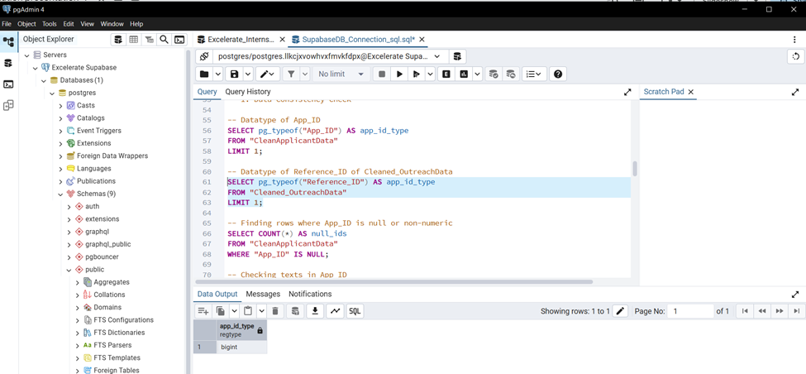
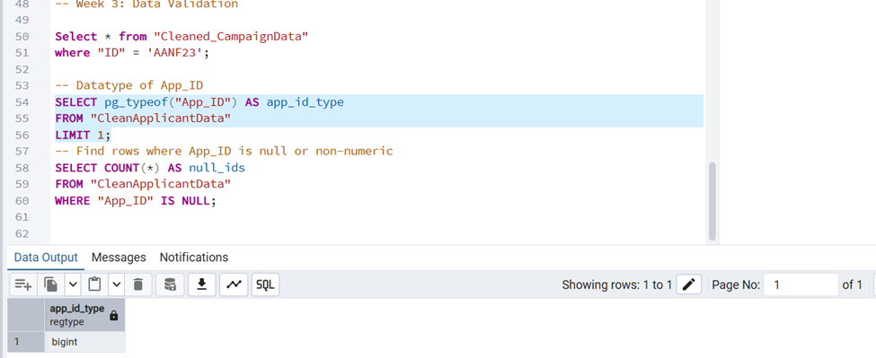
Data Consistency Check
Datatype of App_ID:
SELECT pg_typeof("App_ID") AS app_id_type
FROM "CleanApplicantData"
LIMIT 1;
Datatype of Reference_ID of Cleaned_OutreachData:
SELECT pg_typeof("Reference_ID") AS app_id_type
FROM "Cleaned_OutreachData"
LIMIT 1;

Slide 6
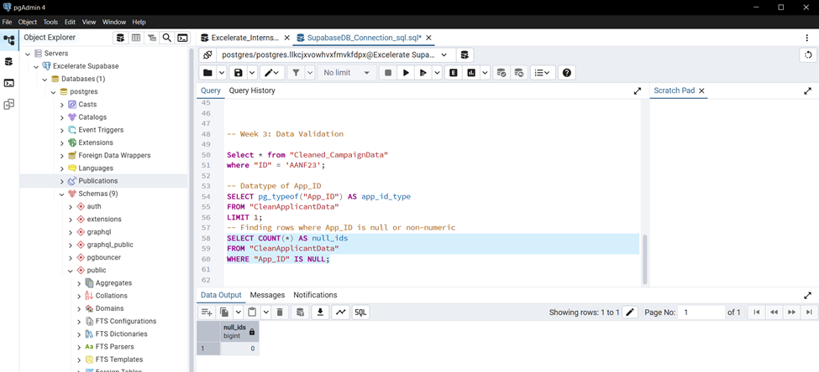
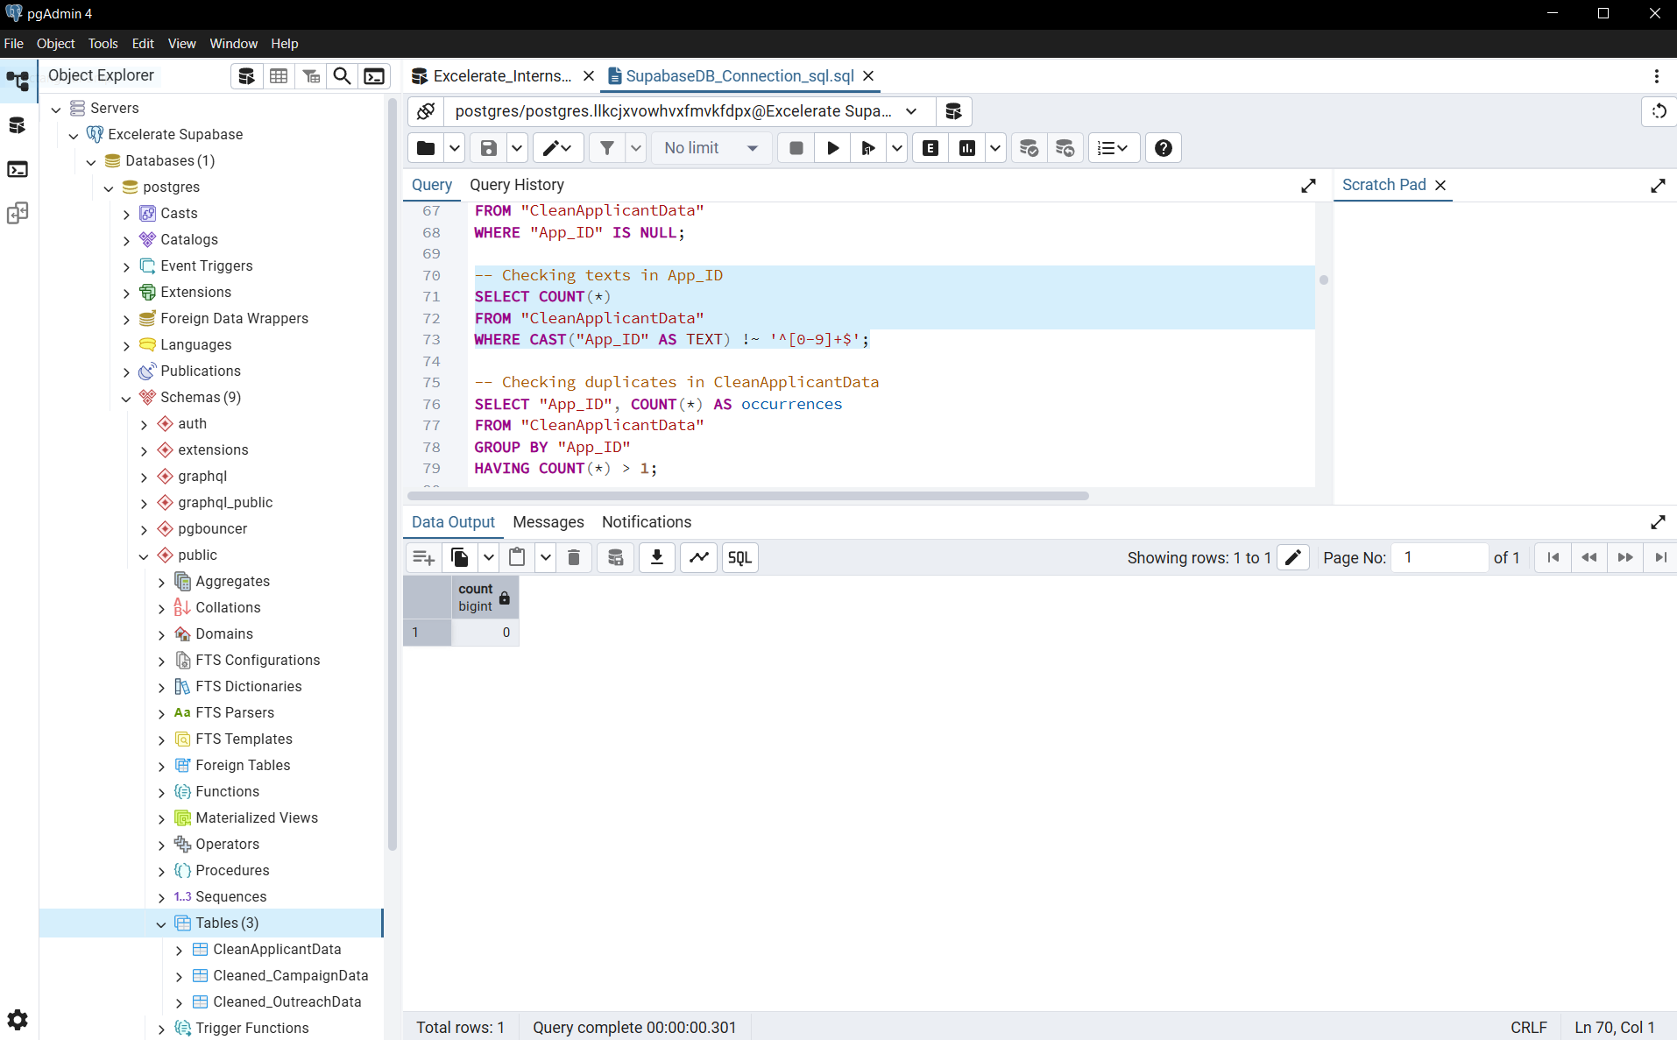
Data Consistency Check
Finding rows where App_ID is non-numeric:
SELECT COUNT(*) AS null_ids
FROM "CleanApplicantData"
WHERE "App_ID" IS NULL;
Checking texts in App_ID:
SELECT COUNT(*)
FROM "CleanApplicantData"
WHERE CAST("App_ID" AS TEXT) !~ '^[0-9]+$';

Slide 7
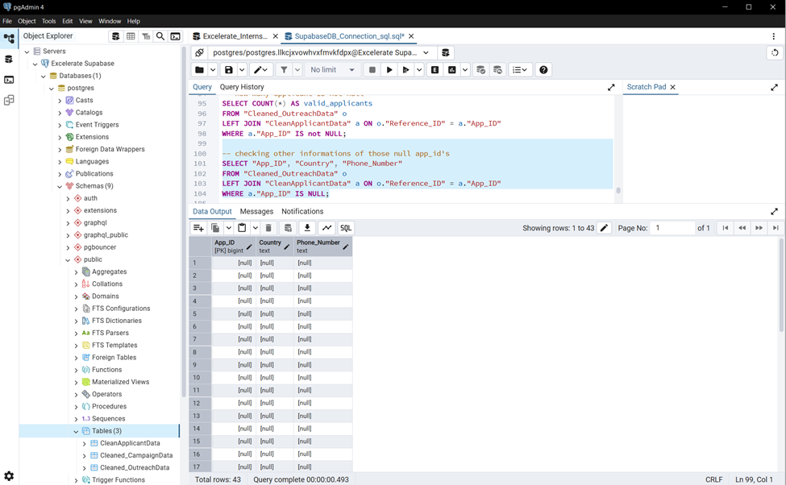
Data Consistency Check
how many applicant ID not null:
SELECT COUNT(*) AS valid_applicants
FROM "Cleaned_OutreachData" o
LEFT JOIN "CleanApplicantData" a ON o."Reference_ID" = a."App_ID"
WHERE a."App_ID" IS not NULL;
Outreach Reference_ID should match ApplicantData.App_ID:
SELECT COUNT(*) AS missing_applicants
FROM "Cleaned_OutreachData" o
LEFT JOIN "CleanApplicantData" a ON o."Reference_ID" = a."App_ID"
WHERE a."App_ID" IS NULL;
So, those null App_ID’s also has null on country and other columns which shows it will not create any issue with other columns.

Slide 8
Data Consistency Check
checking other informations of those null app_id's:
SELECT "App_ID", "Country", "Phone_Number"
FROM "Cleaned_OutreachData" o
LEFT JOIN "CleanApplicantData" a ON o."Reference_ID" = a."App_ID"
WHERE a."App_ID" IS NULL;
1. Out of all outreach records, 42 records referenced invalid applicant IDs that did not exist in the Applicant dataset.
2. These represent ~0.1% of the total (42 / (33076+42)), which is statistically insignificant for overall trends.
3. For the current analysis and visualizations, these records were excluded to maintain data consistency.
4. Future work may involve:
Investigating why these IDs are missing (data entry error, system issue, external applicants).
Either removing them permanently or fixing them if correct references can be found.

Slide 9
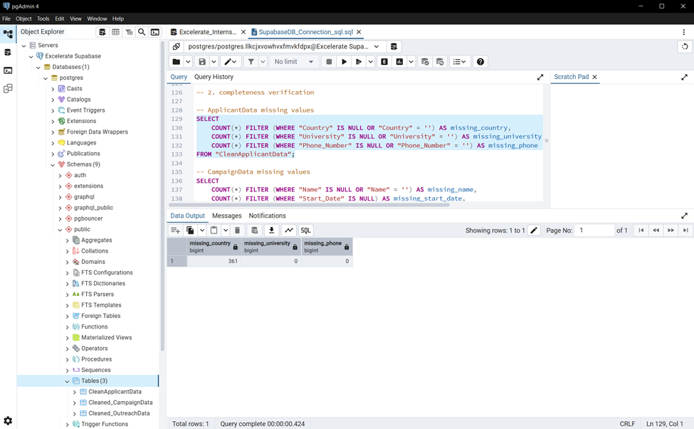
Completeness Verification
ApplicantData missing values:
SELECT
COUNT(*) FILTER (WHERE "Country" IS NULL OR "Country" = '') AS missing_country,
COUNT(*) FILTER (WHERE "University" IS NULL OR "University" = '') AS missing_university,
COUNT(*) FILTER (WHERE "Phone_Number" IS NULL OR "Phone_Number" = '') AS missing_phone
FROM "CleanApplicantData";
The Country column has 361 missing values, representing only 0.2% of the dataset. To account for this, a country filter was added in the dashboard to ensure accurate analysis.

Slide 10
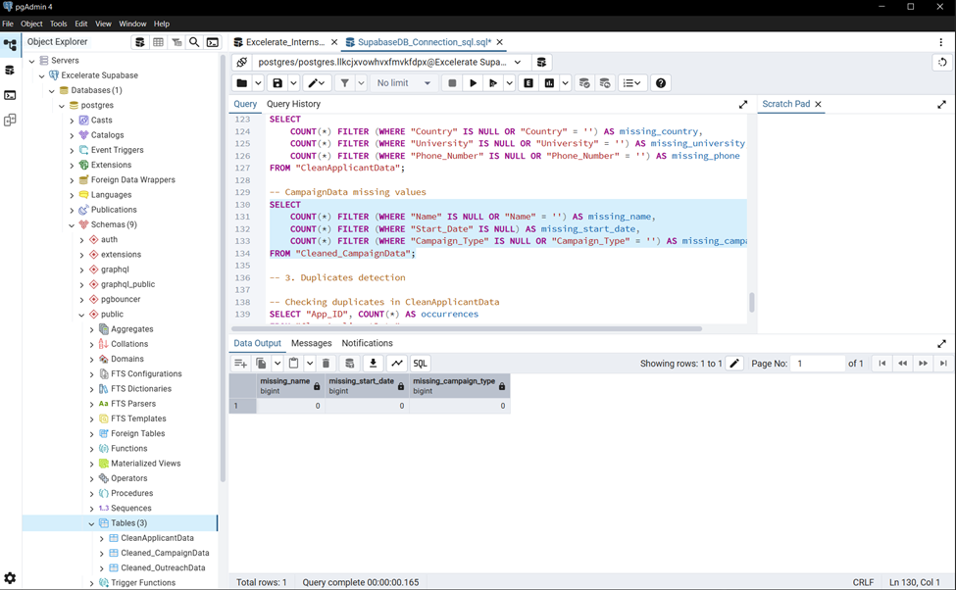
Completeness Verification
CampaignData missing values:
SELECT
COUNT(*) FILTER (WHERE "Name" IS NULL OR "Name" = '') AS missing_name,
COUNT(*) FILTER (WHERE "Start_Date" IS NULL) AS missing_start_date,
COUNT(*) FILTER (WHERE "Campaign_Type" IS NULL OR "Campaign_Type" = '') AS missing_campaign_type
FROM "Cleaned_CampaignData";

Slide 11
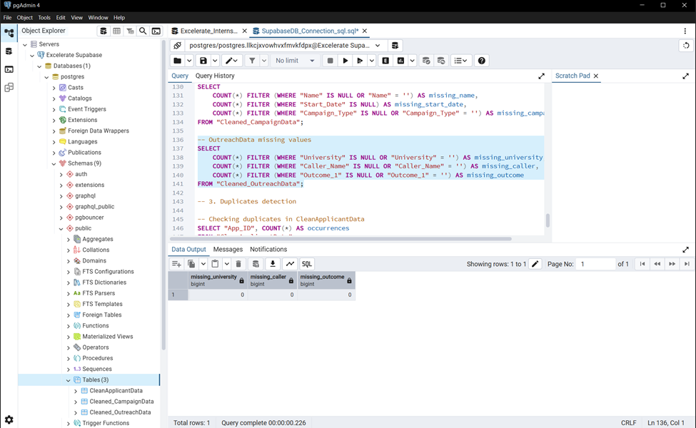
Completeness Verification
OutreachData missing values
SELECT
COUNT(*) FILTER (WHERE "University" IS NULL OR "University" = '') AS missing_university,
COUNT(*) FILTER (WHERE "Caller_Name" IS NULL OR "Caller_Name" = '') AS missing_caller,
COUNT(*) FILTER (WHERE "Outcome_1" IS NULL OR "Outcome_1" = '') AS missing_outcome
FROM "Cleaned_OutreachData";

Slide 12
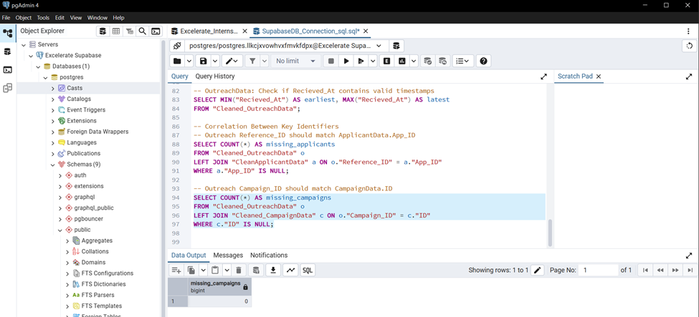
Completeness Verification
Outreach Campaign_ID should match CampaignData.ID:
SELECT COUNT(*) AS missing_campaigns
FROM "Cleaned_OutreachData" o
LEFT JOIN "Cleaned_CampaignData" c ON o."Campaign_ID" = c."ID"
WHERE c."ID" IS NULL;

Slide 13
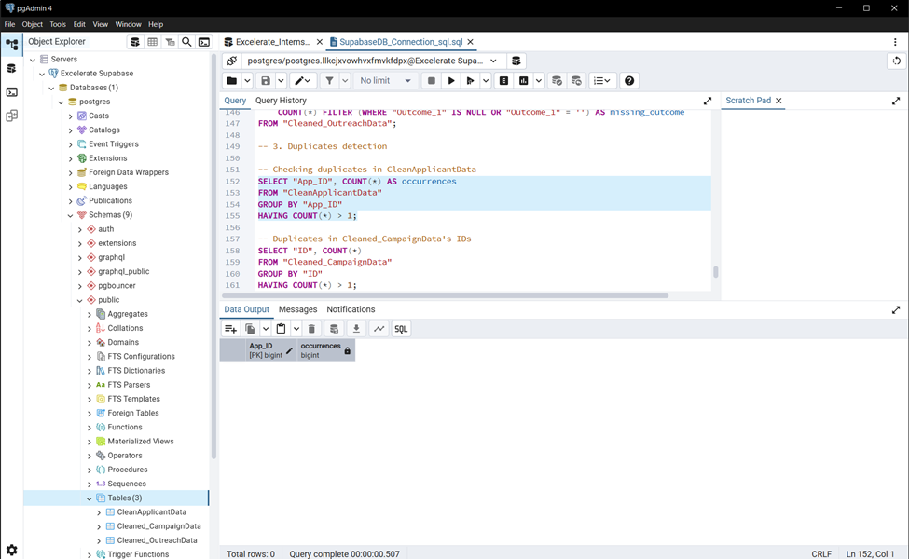
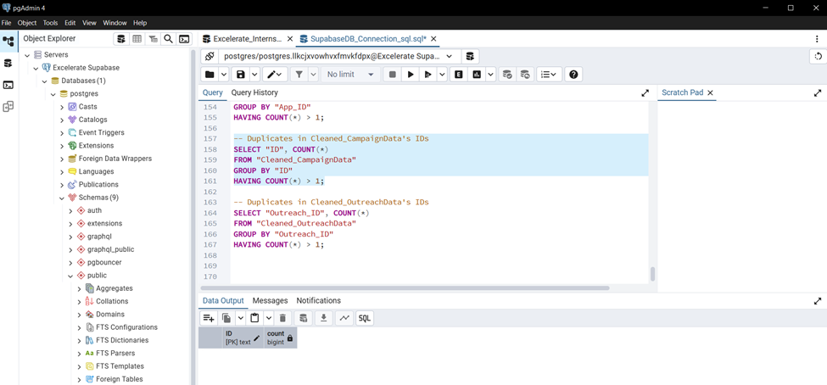
Duplicate Detection
Checking duplicates in CleanApplicantData:
SELECT "App_ID", COUNT(*) AS occurrences
FROM "CleanApplicantData"
GROUP BY "App_ID"
HAVING COUNT(*) > 1;
Duplicates in Cleaned_CampaignData's IDs:
SELECT "ID", COUNT(*)
FROM "Cleaned_CampaignData"
GROUP BY "ID"
HAVING COUNT(*) > 1;

Slide 14
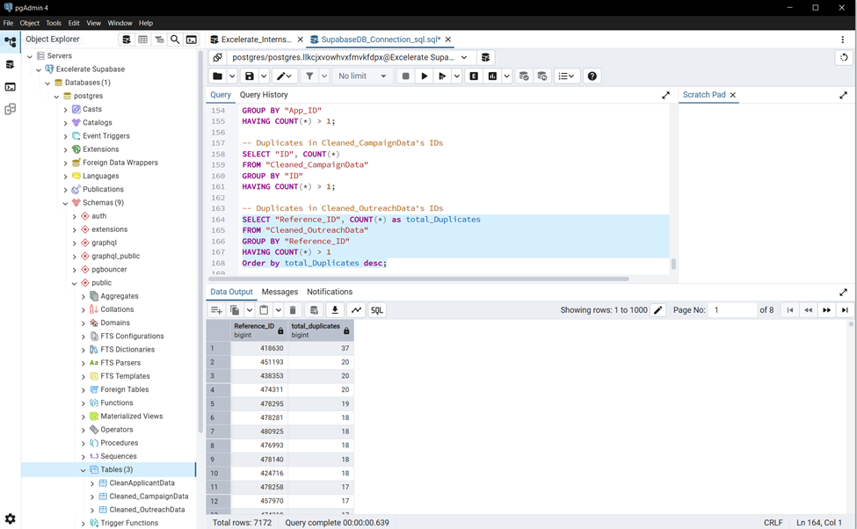
Duplicate Detection
Duplicates in Cleaned_OutreachData's IDs:
SELECT "Reference_ID", COUNT(*) as total_Duplicates
FROM "Cleaned_OutreachData"
GROUP BY "Reference_ID"
HAVING COUNT(*) > 1
Order by total_Duplicates desc;
Here, duplicates is must as “reference_Id” is foreign key.

Slide 15
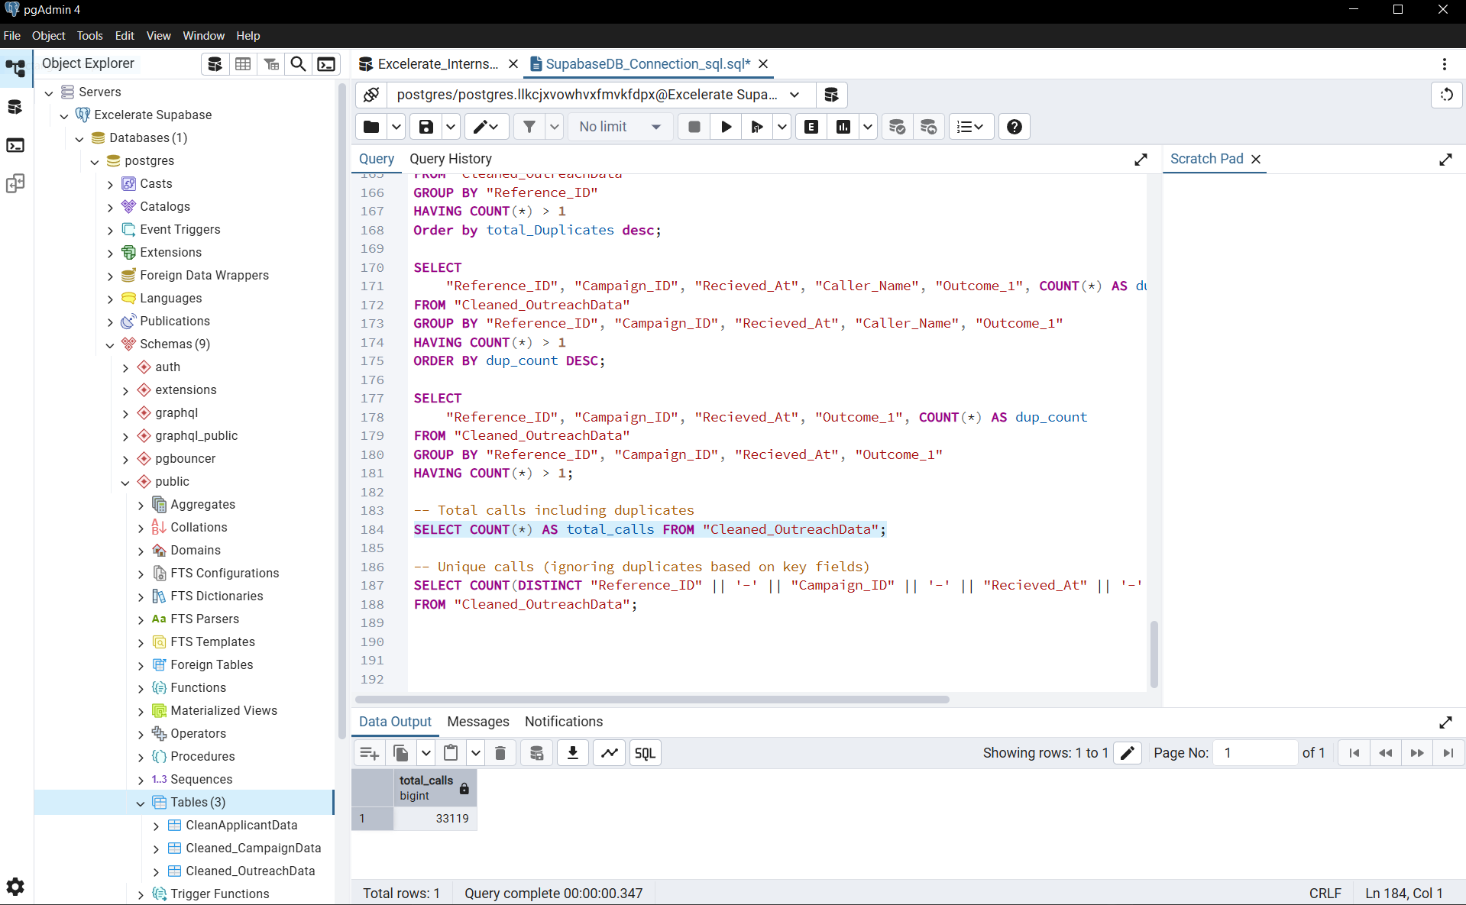
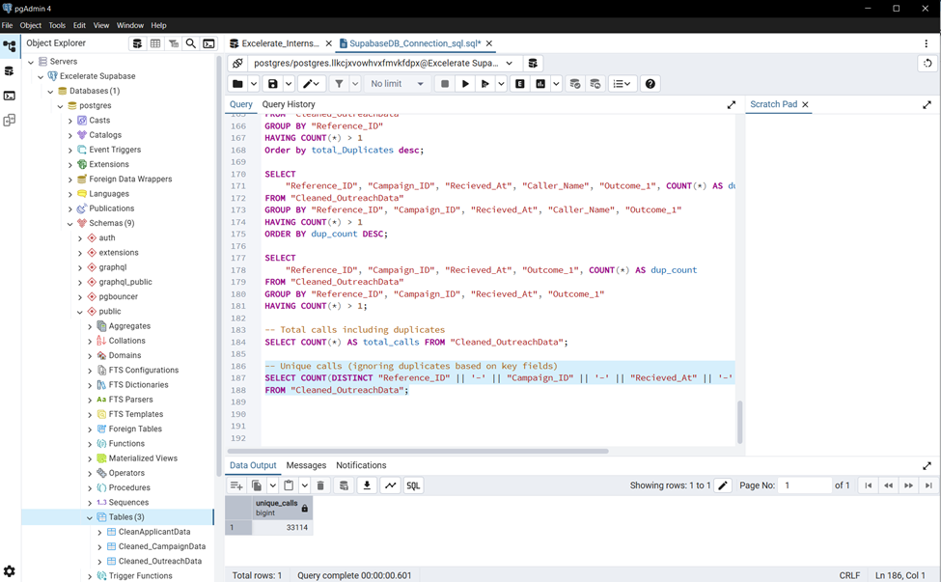
Duplicate Detection
Total calls including duplicates
SELECT COUNT(*) AS total_calls FROM "Cleaned_OutreachData";
Unique calls (ignoring duplicates based on key fields)
SELECT COUNT(DISTINCT "Reference_ID" || '-' || "Campaign_ID" || '-' || "Recieved_At" || '-' || "Outcome_1") AS unique_calls
FROM "Cleaned_OutreachData";
Total calls = 33119
Unique call = 33114
During data validation, we found 5 duplicate call records out of 33,119 total calls, representing approximately 0.015% of the dataset.
This minimal duplication has an insignificant impact on the overall analysis and visualizations. Therefore, these duplicates were not removed for the current analysis, but they can be cleaned in future iterations for complete data integrity.

Slide 16
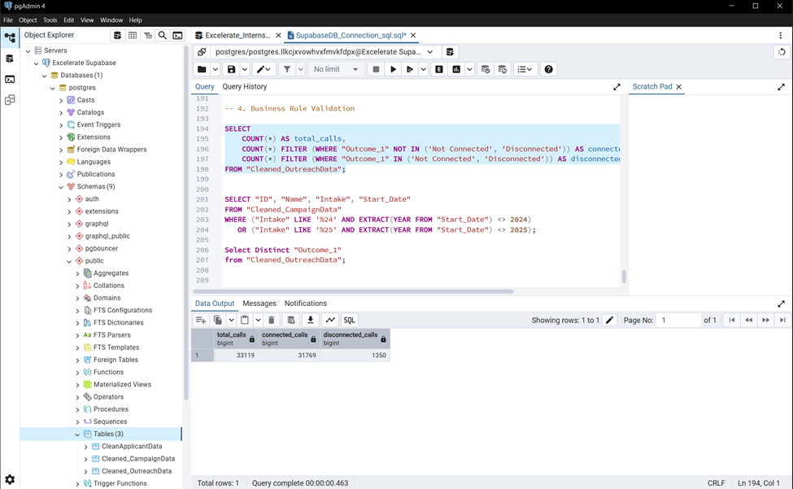
Business Rule Validation
Statistical Record of Total Calls:
SELECT
COUNT(*) AS total_calls,
COUNT(*) FILTER (WHERE "Outcome_1" NOT IN ('Not Connected', 'Disconnected')) AS connected_calls,
COUNT(*) FILTER (WHERE "Outcome_1" IN ('Not Connected', 'Disconnected')) AS disconnected_calls
FROM "Cleaned_OutreachData";
Here, Connected calls = 31769, Disconnected calls = 1350, and Total calls = 33119
For business rule validation, we classified all call outcomes as either Connected or Disconnected.
‘Not Connected’ and ‘Disconnected’ outcomes were grouped as Disconnected, while all other outcomes were considered Connected.
This allowed us to validate total calls against connected and disconnected counts for consistency

Slide 17
Business Rule Validation
Statistical Record of Total Calls:
SELECT
COUNT(*) AS total_calls,
COUNT(*) FILTER (WHERE "Outcome_1" NOT IN ('Not Connected', 'Disconnected')) AS connected_calls,
COUNT(*) FILTER (WHERE "Outcome_1" IN ('Not Connected', 'Disconnected')) AS disconnected_calls
FROM "Cleaned_OutreachData";
Here, Connected calls = 31769, Disconnected calls = 1350, and Total calls = 33119
For business rule validation, we classified all call outcomes as either Connected or Disconnected.
‘Not Connected’ and ‘Disconnected’ outcomes were grouped as Disconnected, while all other outcomes were considered Connected.
This allowed us to validate total calls against connected and disconnected counts for consistency

Slide 18
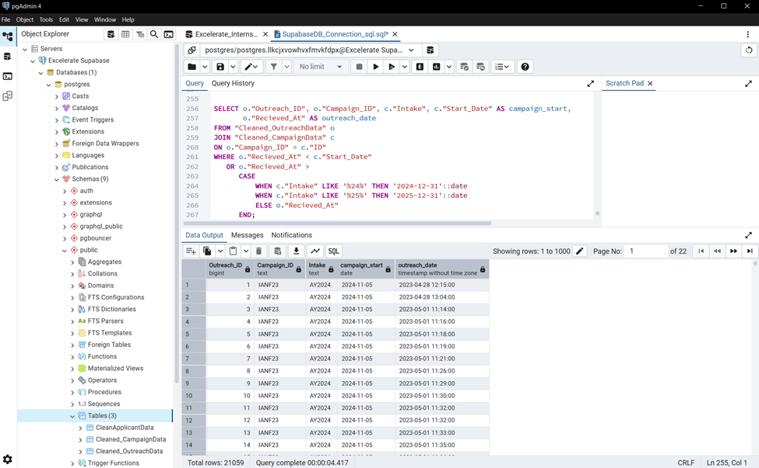
Business Rule Validation
Validation of Campaign and Outreach Timeframes:
SELECT o."Outreach_ID", o."Campaign_ID", c."Intake", c."Start_Date" AS campaign_start,
o."Recieved_At" AS outreach_date
FROM "Cleaned_OutreachData" o
JOIN "Cleaned_CampaignData" c
ON o."Campaign_ID" = c."ID"
WHERE o."Recieved_At" < c."Start_Date"
OR o."Recieved_At" >
CASE
WHEN c."Intake" LIKE '%24%' THEN '2024-12-31'::date
WHEN c."Intake" LIKE '%25%' THEN '2025-12-31'::date
ELSE o."Recieved_At"
END;
Campaigns for intakes FA24 and SP25 were planned for 2024 and 2025, respectively. Outreach and marketing activities began earlier, with some Start_Dates in 2023, which is consistent with standard marketing practice and does not indicate a data error. Business rule validation confirms that no campaign Start_Date exceeds its intake year range.

Slide 19
Key metrics
Connectivity rates
Agent performance measured by:
Connected calls, deposit, admit* , etc.
Campaign success

Slide 20
Connectivity rate
29.86% of the calls where connected.
Total call was 33119
Connected calls = 31769
Disconnected calls = 1350
Majority of the calls were not connected.

Slide 21
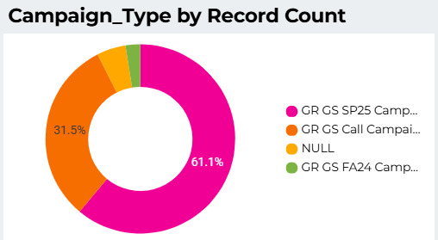
Campaign Types
The GR GS SP25 campaign, dominated, accounting for most of the calls. This could be due to an increase in number of applicants or maybe less clarity during that application season. This campaign was most successful in attracting applicants. (More resources can be allocated to this season).
Can we have a graph to show the timeline of which applicants applied to see the most successful campaign.
31.5% of the calls were not attributed to a known campaign. More effort sure be put in to ensure that the calls are accurately categorized. Also, if needed more categorizes should be included to capture the miscellaneous calls*.

Slide 22
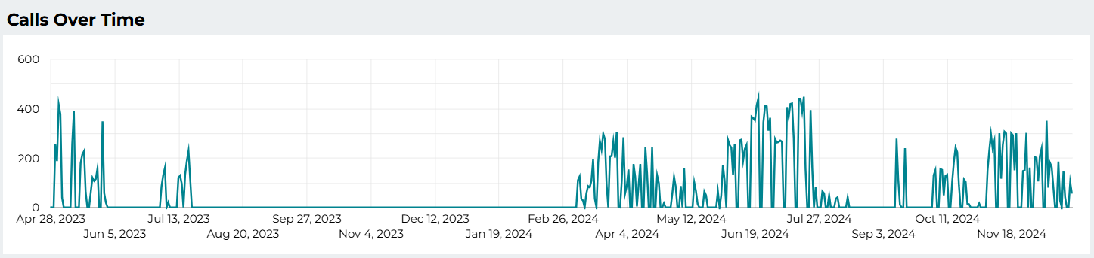
The trend here also shows that the spring season, is the most season active/busy.
There is spike in activity in April 2023 and July 2023, and a similar trend is observed in 2024, but starting in February.
Between February and July 2024 there is significant call activity, although there is a slow down in the month of May.
Although less, there is also more call activity in October and November. With a spike at the onset of September with the commencement of studies*.

Slide 23
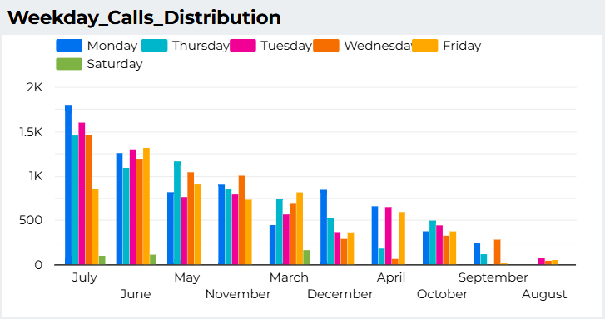
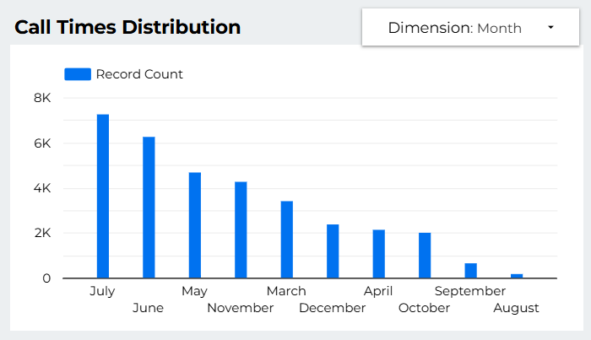
Call Distribution
Similarly this chart shows that June and July are the most active months in terms of calls..

Slide 24
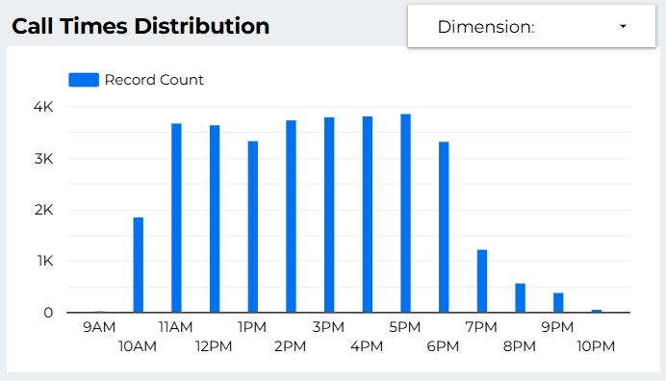
Call Times Distribution
Active call hours are within 11AM to 6PM.
Check calls disconnected by time, as a number and as a percentage/
If it can the control should show the percentage of disconnected calls for each hour (or month and day). Maybe, some more calls are disconnected in a peak season, or is accounting for low call distribution.

Slide 25
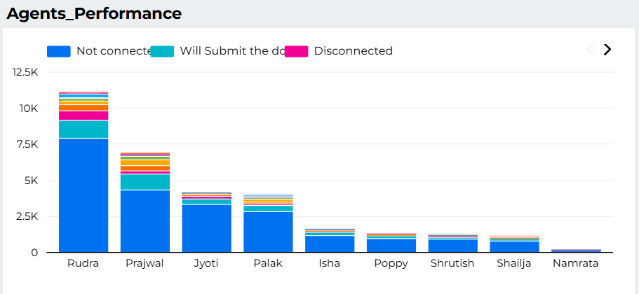
Make it interactive to show the percentage of calls disconnected by each caller, in other words, the success rate per each agent.
Rudra serves the most calls while Namrata has the least.

Slide 26
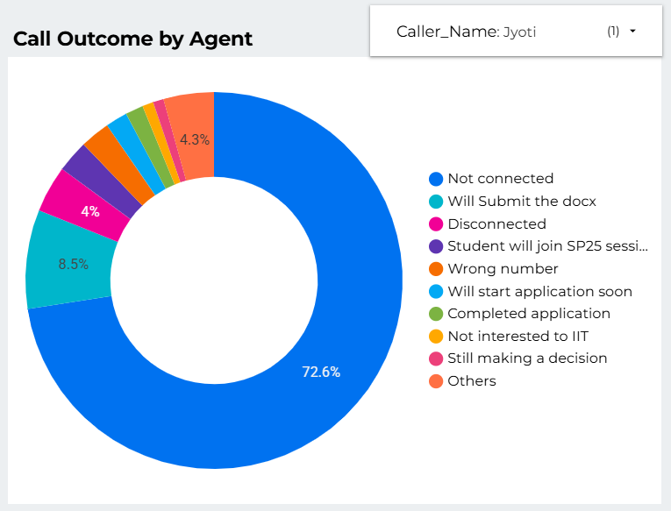
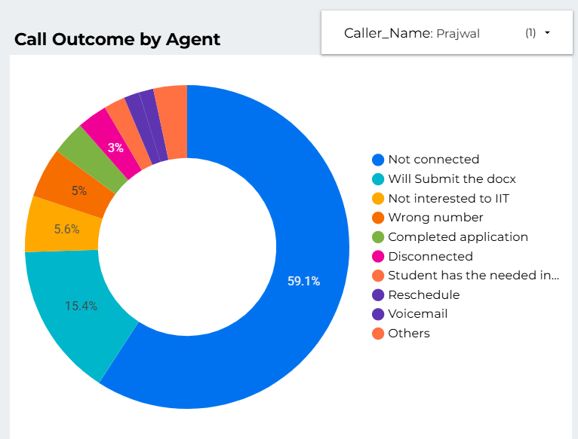
Among agents who serviced over 1000 calls, Prajwal has the least percentage of unconnected calls, whiles Jyoti has the most proportion of unconnected calls.

Slide 27
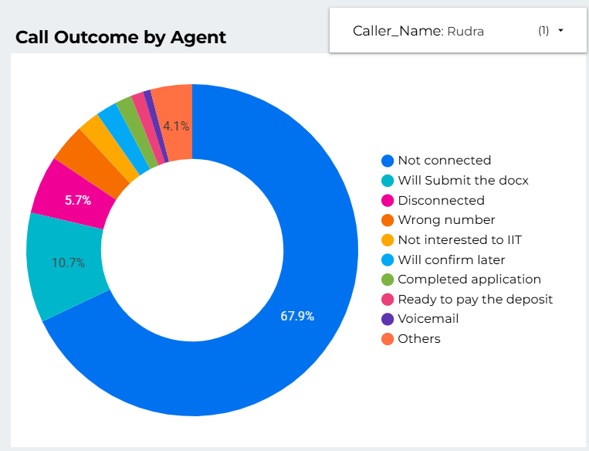
Group the fields into unconnected, need meet, success, failure(not interested, deferral, wrong number)
Rudra had the greates proportion of disconnected calls.

Slide 28
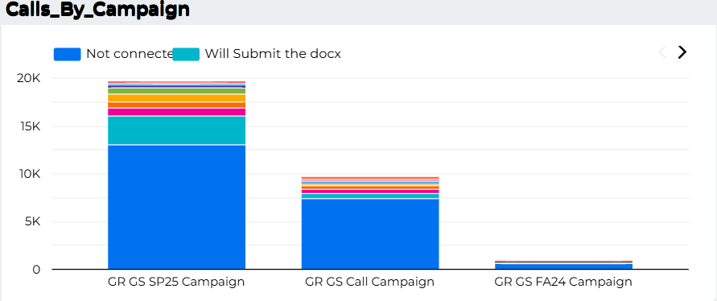
Calls by Campaign
Here, SP25 campaign have the highest calls records and most of them was not connected with the caller.
12916 calls not connected and 3020 will submit their docs.

Slide 29
Agent Performance
It is prominent from the bar chart that Rudra has called more applicants. After Rudra, prajwal, jyoti and palak’s performance was noticeable.
As Rudra contacted more, he has more calls “Not connected” and also engaged with more positive communications on documents submission.

Slide 30
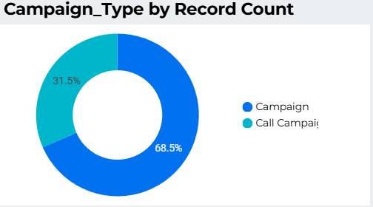
Campaign Type by Record Count
Call Campaign has 31% applicants.
Normal Campaign has 69% of applicants.
Shows applicants prefer interacting in normal campaigns.

Slide 31
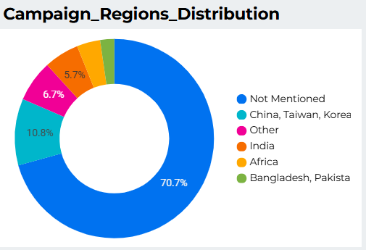
Campaign Regions
Normal campaign (70%) does not have region informations. And that is why more than 70% has “not mentioned” in region column.
On the other hand, 30% of the call campaign have region information which is why 11% (China, taiwan, korea), 7% other and 6% india are found where these campaigns were held.

Slide 32
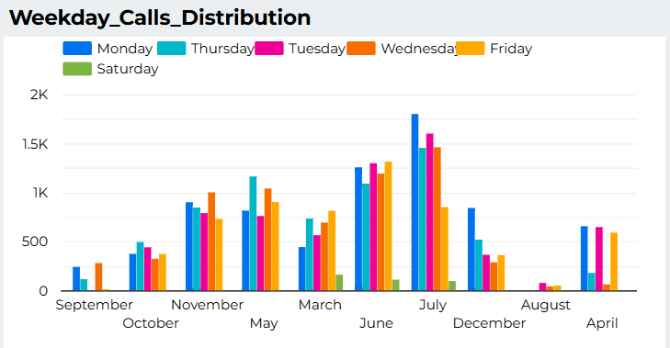
Call Distribution: Month & Weekday
Here, we can see, June, and July months has more applicants communicating with agents. And August month has less interactions than other months.
Also, Monday, Thursday, Tuesday are the busiest day. And Saturday and Friday seems very less interactions which is almost negligible. It may be because, Saturday and Friday are majorly the holidays all around the world.

Slide 33
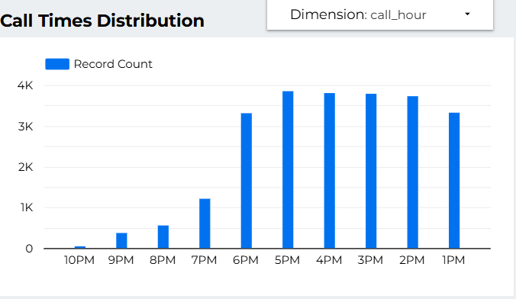
Call time Distribution: Hours
We have used filter to visualize call times distribution on call_month, call_hour, call_Weekday.
Here we can see 10am to 6pm are the busy period of communication. After 6pm and before 10am there are less interactions between agents and applicants.

Slide 34
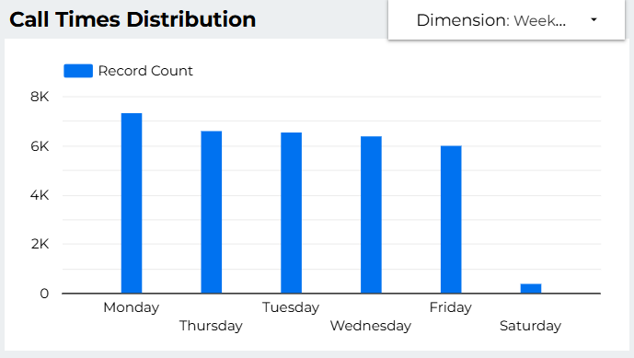
Call Times Distribution: Weekday
We have used filter to visualize call times distribution on call_month, call_hour, call_Weekday.
Here it is visible that Monday, Thursday, Tuesday, Wednesday, and Friday are the busiest day. Saturday has almost no interactions which shows us it is the weekly holiday all around the world.

Slide 35
Call Times Distribution: Month
We have used filter to visualize call times distribution on call_month, call_hour, call_Weekday.
July and June has most interactions between applicants and agents. And August has the least interactions.

Slide 36
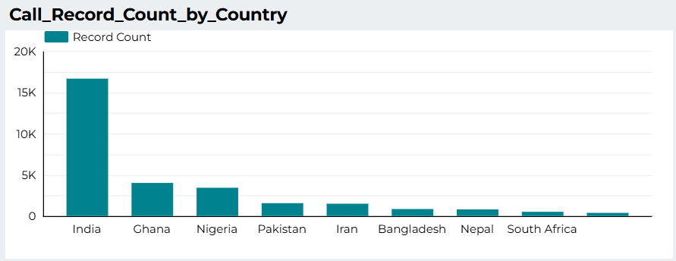
Call Records by Country
From the bar chart it is the visible that India has the highest number of applicants in Illinois Institute of Technology’s marketing campaigns. After India, Ghana and Nigeria has more applicants. And Pakistan, Iran, Bangladesh comes after them.

Slide 37
Summary of data
These KPI’s shows, there are 15,159 total applicant who contacted with 12 agents in calls. These applicant were from 143 different countries and engaged with 3 campaigns.
There were total 33119 interactions between applicants and campaign’s marketing agents which have almost 30% successful calls.

Slide 38
What are the key takeaways?
Findings
India has most applicants.
June and July are the most busy period of the year in this marketing campaign.
Monday to Friday are busy period of week and Saturday is off day.
10am to 6pm is the peak period of the day for calls.
Rudra is the Top performer from all the agents/callers.
Country column had 361 missing values (0.2%).
42 outreach records had no matching applicant IDs (orphan records).
Duplicate outreach entries inflated total calls by 5 records (0.01%).
Connected + Disconnected calls = Total calls (business rule validated).
Campaign Start_Dates began in 2023 for FA24 and 2024 for SP25, consistent with marketing practice.
No campaign exceeded its intake year timeframe.

Slide 39
Recommendations
Provide bonuses or other commissions to agents which will improve productivity.
Continue early marketing since 2023 outreach supported 2024 intakes.
Focus campaigns in high-engagement regions for better ROI.
Engage more with Indian applicants as they are showing more interest.
Providing discounts for applicants from low income countries like Nigeria, Ghana will increase the positive interactions.

Slide 40
Future work
Address missing applicant data through better collection methods.
Remove duplicates before reporting to avoid inflated metrics.
Improve applicant linkage for outreach to reduce orphan records.
Removing data of those 43 Reference_Id’s which is connected with 43 null App_IDs.

